Slide 1
Transportation &
Logistics Systems
Session 4
Transportation Planning
January 29, 2019

Slide 2
Announcements
HW 2 Graded
Average: 134.2
Median: 134
SD: 10.46
HW 3 due now
HW 4 (teamwork) due next Week
Final exam
  Available: 12:01 AM, Feb 7; due 11:59 PM Feb 13, 2019
  Check “Exam” folder in Bb
  The test will have detailed instructions
  Strictly individual

Slide 3
Logistics Strategy Triangle
Inventory Strategy
Inventory Strategy
•
Forecasting
Forecasting
Transport Strategy
Transportation Strategy
•
Inventory decisions
Inventory decisions
•
Transport fundamentals
•
Purchasing and supply
Transport fundamentals
Purchasing and supply
Customer
•
Transport decisions
Storage fundamentals
Customer
Transportation decisions
scheduling decisions
service goals
•
Storage decisions
service goals
Storage fundamentals
•
The product
CONTROLLING
•
Storage decisions
The product
ORGANIZING
ORGANIZING
PLANNING
CONTROLLING
Logistics service
PLANNING
•
Logistics service
•
Ord
Ord. Proc. & Info system
. proc. & info. sys.
Location Strategy
Location Strategy
•
Location decisions
Location decisions
•
The network planning process
The network planning process

Slide 4
Lecture Outline
Case: HP DeskJet
Intro to Transportation Planning
Transportation Modeling
Summary

Slide 5
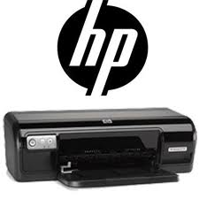
Outline: HP DeskJet
Problems & Causes
Improvement Opportunities
  Short-term
  Long-term
Lessons Learned

Slide 6

HP DeskJet Case: Analysis
Problems
  High inventory levels
  Inventory imbalance in Europe
Causes
  Uncertainty about correct inventory levels
  Many geographic options (localization)
  Long lead times
  Uncertain market
  Difficulty at getting divisions to work together
What are HP’s options?

Slide 7
Outline: HP DeskJet
Problems & Causes
Improvement Opportunities
  Short-term
  Long-term
Lessons Learned

Slide 8
HP: Options
Short Term
  Rationalize safety stock
Long Term
  Air shipment
  European factory
  More inventory
  Better forecasting
  DC localization

Slide 9
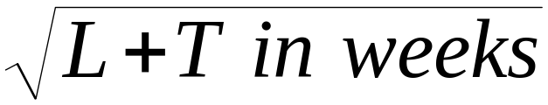
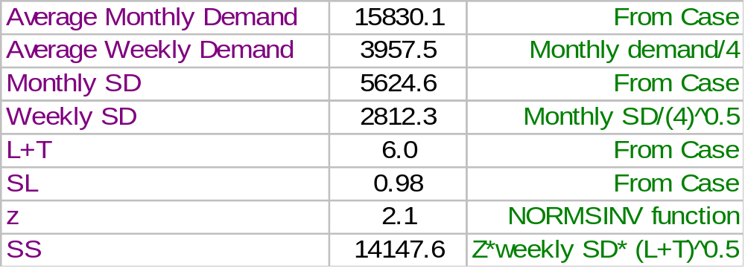
Example: SS Calculations
Product AB
Safety Stock = z × weekly SD *

Slide 10

HP: Options
Short Term
  Rationalize safety stock
Long Term
  Air shipment
  European factory
  More inventory
  Better forecasting
  DC localization

Slide 11
HP DeskJet Case
Ocean
Transport
Current
Q2(b)
Air
Transport
Q2(a)
Not asked
☹
No postponement
(6 products)
Postponement
(1 generic product)

Slide 12
Inventory Holding Cost
Holding (or carrying) costs
  Costs for storage, handling, insurance, tax, obsolescence etc.
  Expressed as a % of product cost every year
  So if production cost is $400.00 and holding cost is 12% then it costs HP $400*12% = $48/printer/year to hold inventory
Notes:
5

Slide 13
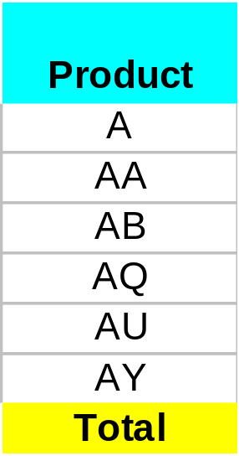
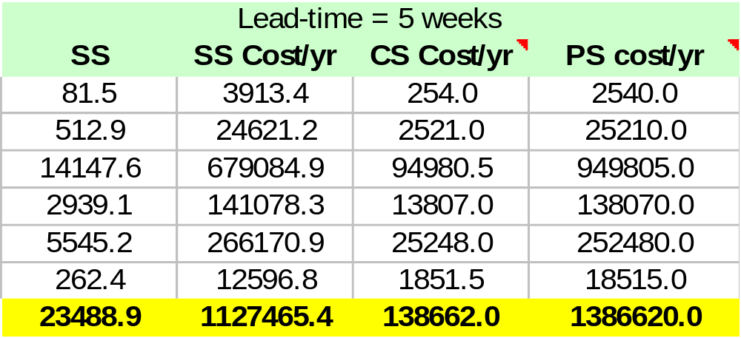
Total Cost: Ocean Shipment
SS Cost per year = h * SS ( L = 5 week, L + T = 6, SS = z * σ_{T+L})
In transit cost per year = h * PS (Pipeline stock = Lead time * μ )
Cycle cost per year = h * CS (Cycle stock = μ * T/2 )
Assume
Holding cost h = 12%
i.e. $48/unit/year
Total:
$2.605 M/yr

Slide 14
Air Shipment & Recommendation
Air Shipment
  What Changes?
    L = 1 week. Impact?
    PS and SS will go down
  Repeat all calculations with new L
  Total inventory holding cost (air shipment): $1.039 M/year
Comparison & Recommendation
  Total inventory holding cost (ocean transportation): $2.605 M/year
  SS+PS savings in air transportation: $1.565 M/year
  Use air if the rate difference is less than $1.565M/year

Slide 15
HP: Options
Short Term
  Rationalize safety stock
Long Term
  Air shipment
  European factory
  More inventory
  Better forecasting
  DC localization

Slide 16
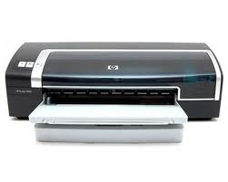
Evaluating Alternatives
European Factory
  Sufficient volume?
Better Forecasting, how?
Golden Rules of Forecasting
  All forecasting methods have errors
  Error increases as forecast horizon increases
  Aggregate forecasting is more accurate than SKU level forecasting
More Inventory
  More problems

Slide 17
HP: Options
Short Term
  Rationalize safety stock
Long Term
  Air shipment
  European factory
  More inventory
  Better forecasting
  DC localization

Slide 18
Postponement or
Delayed Differentiation
What is it?
Postpone changes in form/identity of a product to the last possible point
Postpone inventory location to the last possible point in time
Examples:
  Hold inventory in component form
  Mixing paints at home improvement stores
  Dye wool clothing after knitting
  Tailoring of formal clothing at store
Speculation
  Opposite of postponement, where a player assumes risk

Slide 19
Back to the HP case ..

Slide 20
HP DeskJet Case
Ocean
Transport
Current
Q2(b)
Air
Transport
No postponement
(6 products)
Postponement
(1 generic product)

Slide 21
Current Production Process
Raw wafers
ASIC
Power supply
Print mechanism
Raw PCB
PCB
DeskJet
printer
Finished
products
A
AA
AB
AQ
AU
AY
AK
Raw head
drive board
Cables
Keypad
Motors
Plastics
Manuals
HP Vancouver

Slide 22
DC Localization
(postponement or delayed differentiation)
Raw wafers
ASIC
Power supply
Print mechanism
Raw PCB
PCB
DeskJet
printer
Finished
products
A
AA
AB
AQ
AU
AY
AK
Raw head
drive board
Cables
Keypad
Motors
Plastics
Manuals
Generic
Printer
HP Vancouver
European DC

Slide 23
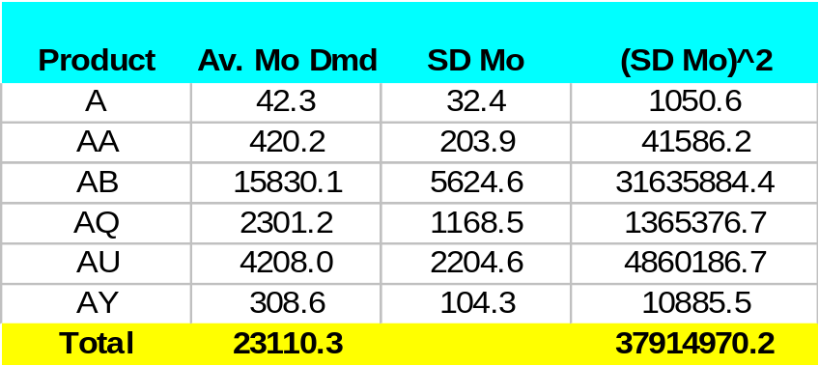

Evaluating DC Localization
(Ocean Transportation)
1. Find demand distribution for generic product
Will the PS &
CS change?
MONTHLY Demand
Mean = 23110.3
SD = SQRT(37914970) = 6157.5
WEEKLY Demand
Mean = 23110.3/4 = 5777.6
SD = 6157/SQRT(4) = 3078.7
2. Use demand distribution to find SS
Safety Stock =
= z × weekly SD *
= 15,488
Current SS: 23,489

Slide 24
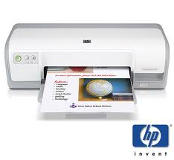
DC Localization
Safety Stock Reduction
  Current 23,489 units
  With localization 15,488 units
Other benefits
  Lower value of transit inventory
  Freight reductions
  Local presence of “manufacturing”
  Customs implications
  Local procurement of localization materials
Issues in
global SCM
But there are costs
  Product redesign
  DC modifications

Slide 25
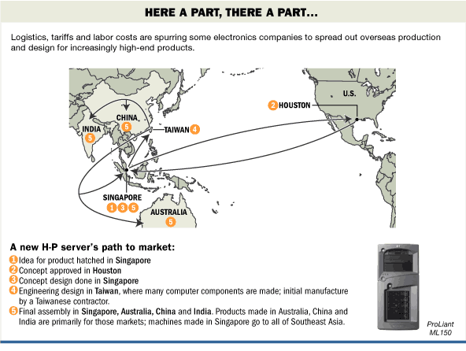
HP Servers
Source: The Wall Street Journal, February 23, 2004

Slide 26
Outline: HP DeskJet
Problems & Causes
Improvement Opportunities
  Short-term
  Long-term
Lessons Learned

Slide 27
Results: What Happened
Successful implementation
Millions saved
Service levels improved
Packaging won awards
Best practice!
  HP Laserjet example
Recent Information
1999: Outsourcing to china
(no postponement)
2005+: Postponement again!
(Factory in E. Europe)
Complementary Reading
Inventory-Driven Costs, HBR, March 2005

Slide 28
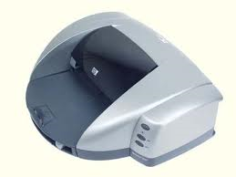
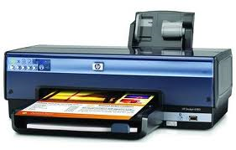
HP: Lessons Learned
Calculations!
Benefits of postponement
Risk pooling
  Other examples discussed
    Component commonality (Ford, GM, Toyota)
    Gap, Old Navy: Centralize inventory on non-standard sizes
Global SCM issues

Slide 29
Lecture Outline
Case: HP DeskJet
Intro to Transportation Planning
Transportation Modeling
Summary

Slide 30
Introduction
Movement of product from one location to another
Products rarely produced and consumed in the same location
Significant cost component
Shipper requires the movement of the product
Carrier moves or transports the product

Slide 31
Transportation Modes
Trucks
Rail
Air
Package Carriers
Water
Pipeline
These are qualitative & rather easy!
We will discuss these towards the
end of today’s class.
Let us jump to modeling first
Notes:
31
Notes:

Slide 32
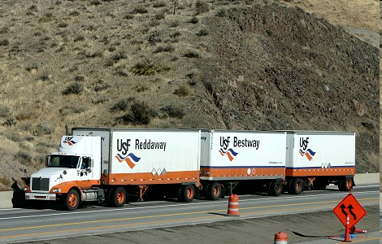
Trucks
Accounts for 75% of freight bill in the US
Major players: Schneider National, JB Hunt, Ryder
TL
LTL
Average revenue per ton-mile (2013) = 9.13 cents
Average haul = 274 miles
Low fixed and variable costs
Major Issues
  Utilization
  Consistent service
  Backhauls
Average revenue per ton-mile (2013) = 16.54 cents
Average haul = 646 miles
Higher fixed costs, low variable costs
Major Issues
  Location of consolidation facilities
  Utilization
  Vehicle routing
  Customer service
Notes:
32
Notes:

Slide 33

Transportation Modes
Trucks
Rail
Air
Package Carriers
Water
Pipeline
Notes:
33
Notes:

Slide 34
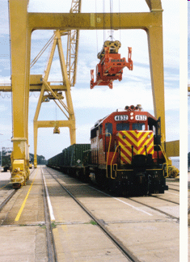
Rail
Average revenue / ton-mile (2013) = 4.05 cents
Average haul = 720 miles
Average load = 80 tons
Major Players: CSX, CN, BNSF
Key Issues
  Scheduling to minimize delays / improve service
  Off track delays (at pick up and delivery end)
  Variability of delivery times
Notes:
34
Notes:

Slide 35
Transportation Modes
Trucks
Rail
Air
Package Carriers
Water
Pipeline
Notes:
35
Notes:

Slide 36
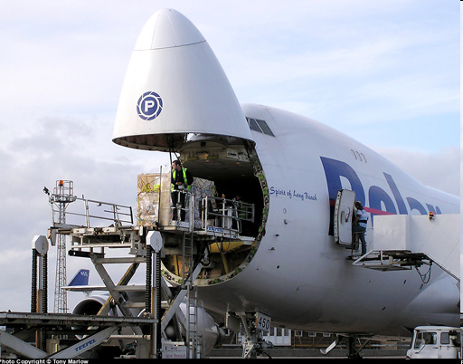
Air
Fast and expensive
Small, high value items, light weight (Ex. Tech)
Key Issues
  Location/Number of hubs
  Location of fleet bases / crew bases
  Schedule optimization
  Fleet assignment
  Crew scheduling
  Revenue management
Notes:
36
Notes:

Slide 37
Transportation Modes
Trucks
Rail
Air
Package Carriers
Water
Pipeline
Notes:
37
Notes:

Slide 38
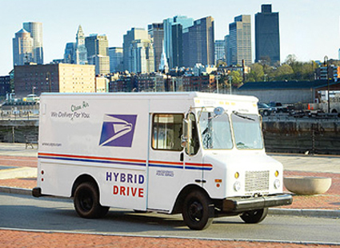
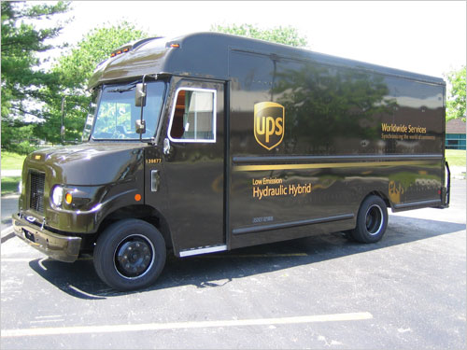
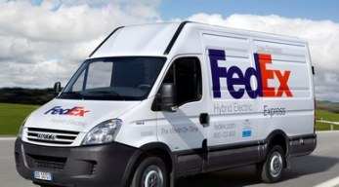
Package Carrier
Different service classes
Low vol., light weight items,
Key Issues
  Location/Number of hubs
  Location of fleet bases
  Vehicle routing
  Crew scheduling
  Managing different service classes
  First and last mile

Slide 39
Transportation Modes
Trucks
Rail
Air
Package Carriers
Water
Pipeline
Notes:
39
Notes:

Slide 40
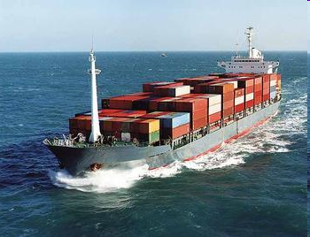
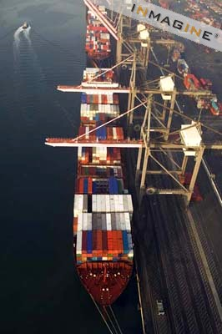
Water
Chief enabler of global trade
Used when no land route available
Very high vol., heavy items
Low cost
Minimal pollution
50,000 commercial vessels, flags from over 150 countries
Global tonnage: 8.9 Billion tons (2011)
Data Source: Fortune, May 21, 2012

Slide 41
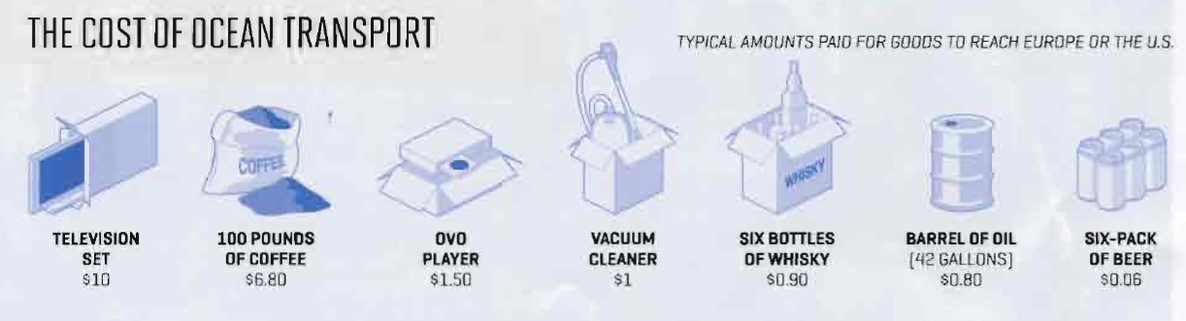
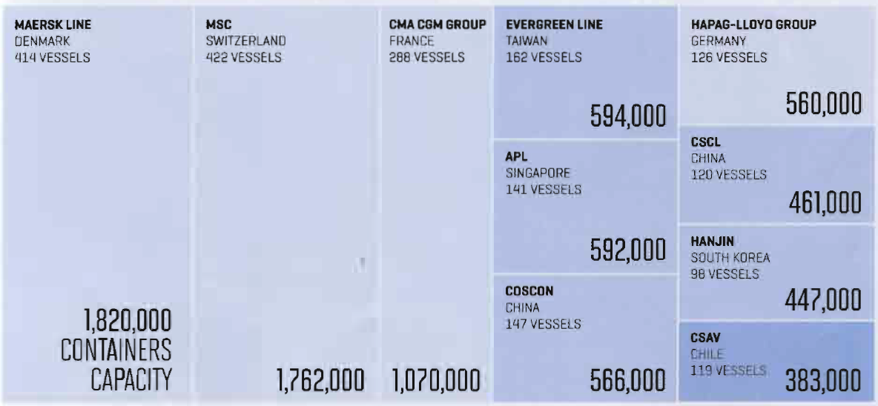
Shipping Cost (2011)
Top Container Operators (2011)
Source: Fortune, May 21, 2012

Slide 42
Potential Issues
Lack of Port Capacity
Long Lead Times
Holding cost (PS/SS)
Security & regulations
Panama canal expansion

Slide 43
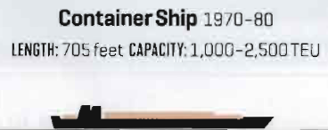
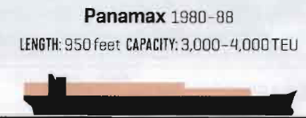
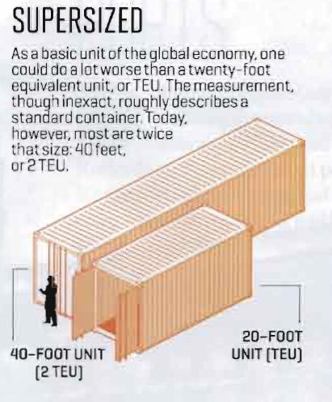
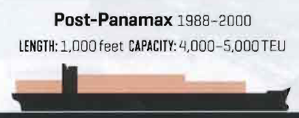
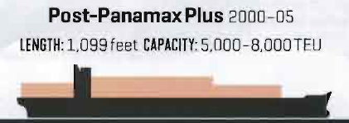
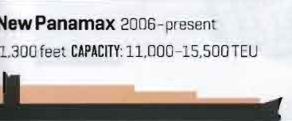
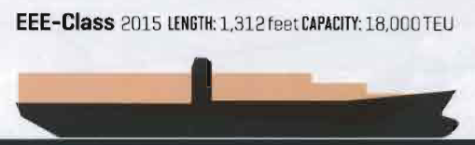
Cargo Ships
Source: Fortune, May 21, 2012

Slide 44
Transportation Modes
Trucks
Rail
Air
Package Carriers
Water
Pipeline
Notes:
44
Notes:

Slide 45
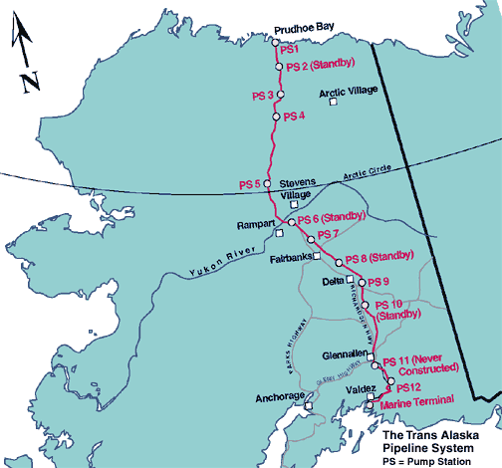
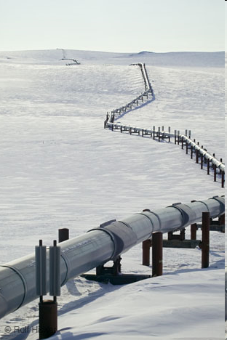
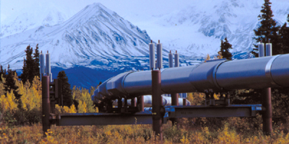
Pipeline
Slow, reliable
Standardized handling procedure
Key Issues
  Fixed cost
  High volume
  Special maintenance requirements

Slide 46
Transportation Modes
Trucks
Rail
Air
Package Carriers
Water
Pipeline
Notes:
46
Notes:

Slide 47
Intermodal Transportation
Use of more than one mode of transportation to move a shipment
Grown considerably with increased use of containers
May be the only option for global trade
Convenient for shippers
Key issue – exchange of information to facilitate transfer between different modes

Slide 48
Lecture Outline
Case: HP DeskJet
Intro to Transportation Planning
Transportation Modeling
Summary

Slide 49
Solver Review:
MSR Marketing
MSR, a marketing consulting firm, is planning the ad campaign of a large consumer packaged
goods (CPG) firm. The firm would like to reach a minimum of 1.5 million audience with lowest
possible cost. It is considering 4 outlets, each with a different audience size and different cost
as described below.
 | TV | Radio | Newspaper | Internet
Audience size per ad | 50,000 | 25,000 | 20,000 | 15,000
Cost of one ad | $500 | $200 | $250 | $125
Maximum # of ads | 20 | 15 | 10 | 15
For example, an ad on TV costs $500.00 and reaches 50,000 audience. The firm does not want
Too many adds on a single ad outlet. As a result, it has limits on maximum # of ads for each
outlet. What solution/advice should MSR offer to this CPG firm?

Slide 50
Introduction
Shipper
  Party that requires movement of goods (customer)
  Minimizes total cost (transport + inventory + other applicable costs)
Carrier
  Party that moves the product
  Invests in transportation equipment
  Often makes routing decisions
Lane
  Any origin-destination pair
Many different types of models

Slide 51
Outline: Transportation Models
Mode/Service selection
Private fleet planning
  Routing from multiple points
  Vehicle routing and scheduling
Freight consolidation

Slide 52
Mode/Service Selection Model
Example: the HP DeskJet Printer case
What would we do if we had transportation costs (ocean, air)?
Would select a mode/service that minimizes total cost per year
Total cost per year = total transportation cost + total SC inventory cost
  Calculate SS, PS, CS costs per year
  Calculate: transportation cost = rate * avg. shipment volume in a year
Select the least cost option
Key takeaway from mode selection model:
Make transportation & inventory decisions together

Slide 53
Outline: Transportation Models
Mode/Service selection
Private fleet planning
  Routing from multiple points
  Vehicle routing and scheduling
Freight consolidation

Slide 54
703 Manufacturing:
Routing from Multiple Points
(also called the demand allocation model)
1675
Supplier A
400
Market 1
Supply ≤ KA
Requirements = D1
Supplier B
Market 2
Supply ≤ KB
Requirements = D2
Supplier C
Market 3
Supply ≤ KC
Requirements = D3
.

Slide 55
703 Manufacturing:
Routing from Multiple Points
A set of plants (suppliers) and markets (customers)
  Each supplier has capacity limits, prod. Cost
  Each market has known demand
  Transportation cost plant to market
Plant | Production/Transportation Cost to Market |  |  |  |  |  | Capacity
 | Atlanta | Boston | Chicago | Denver | Omaha | Portland
Baltimore | 1675 | 400 | 685 | 1630 | 1160 | 2800 | 18
Chayenne | 1460 | 1940 | 970 | 100 | 495 | 1200 | 24
Salt Lake | 1925 | 2400 | 1425 | 500 | 950 | 800 | 27
Memphis | 380 | 1355 | 543 | 1045 | 665 | 2321 | 22
Wichita | 922 | 1646 | 700 | 508 | 311 | 1797 | 31
Demand/Mo | 10 | 8 | 14 | 6 | 7 | 11
Which plant will serve which market?

Slide 56
What Did we do?
The Demand Allocation Model
Which market is served by which plant?
Which supply sources are used by a customer?
Minimize {Total production & transportation cost}
Subject to:
  Shipment to a market must equal its demand
  Shipment from a plant cannot exceed its capacity
  Shipment cannot be negative

Slide 57
What if there is a fixed cost of running a plant?

Slide 58
Routing from Multiple
Points with Fixed Cost
Plant | Production/Transportation Cost to Market |  |  |  |  |  | Capacity
 | Atlanta | Boston | Chicago | Denver | Omaha | Portland
Baltimore | 1675 | 400 | 685 | 1630 | 1160 | 2800 | 18
Chayenne | 1460 | 1940 | 970 | 100 | 495 | 1200 | 24
Salt Lake | 1925 | 2400 | 1425 | 500 | 950 | 800 | 27
Memphis | 380 | 1355 | 543 | 1045 | 665 | 2321 | 22
Wichita | 922 | 1646 | 700 | 508 | 311 | 1797 | 31
Demand/Mo | 10 | 8 | 14 | 6 | 7 | 11
Fixed Cost
7650
3500
5000
4100
2200
Which plant will serve which market?

Slide 59
Outline: Transportation Models
Mode/Service selection
Private fleet planning
  Routing from multiple points
  Vehicle routing and scheduling
Freight consolidation

Slide 60
Routing Decisions
Depot
  Hub or base of all vehicles
  Vehicles start and end a day at the depot
  Vehicles could be of same or different size/capacity
  Scheduled delivery/pickup
Objective: minimize total distance travelled by all vehicles
What are good rules for routing?

Slide 61
Practical Guidelines for
Good Routing
1. Load trucks with stop volumes that are in closest proximity to each other
Stops
D
D
Depot
Depot
(a) Weak clustering
(b) Better clustering

Slide 62
Guidelines (Cont’d)
2. Stops on different days should be arranged to produce tight clusters
F
T
F
T
F
F
T
T
T
F
F
F
T
T
F
T
T
T
F
T
F
F
F
T
Stop
T
T
F
F
D
D
Depot
May need to coordinate with sales to achieve clusters
Depot
(a) Weak clustering--
(b) Better clustering
routes cross

Slide 63
Guidelines (Cont’d)
3. Build routes beginning with the farthest stop from the depot
4. The stop sequence on a route should form a teardrop pattern

Slide 64
How to get “tear drops”?
Well, by trial and error

Slide 65
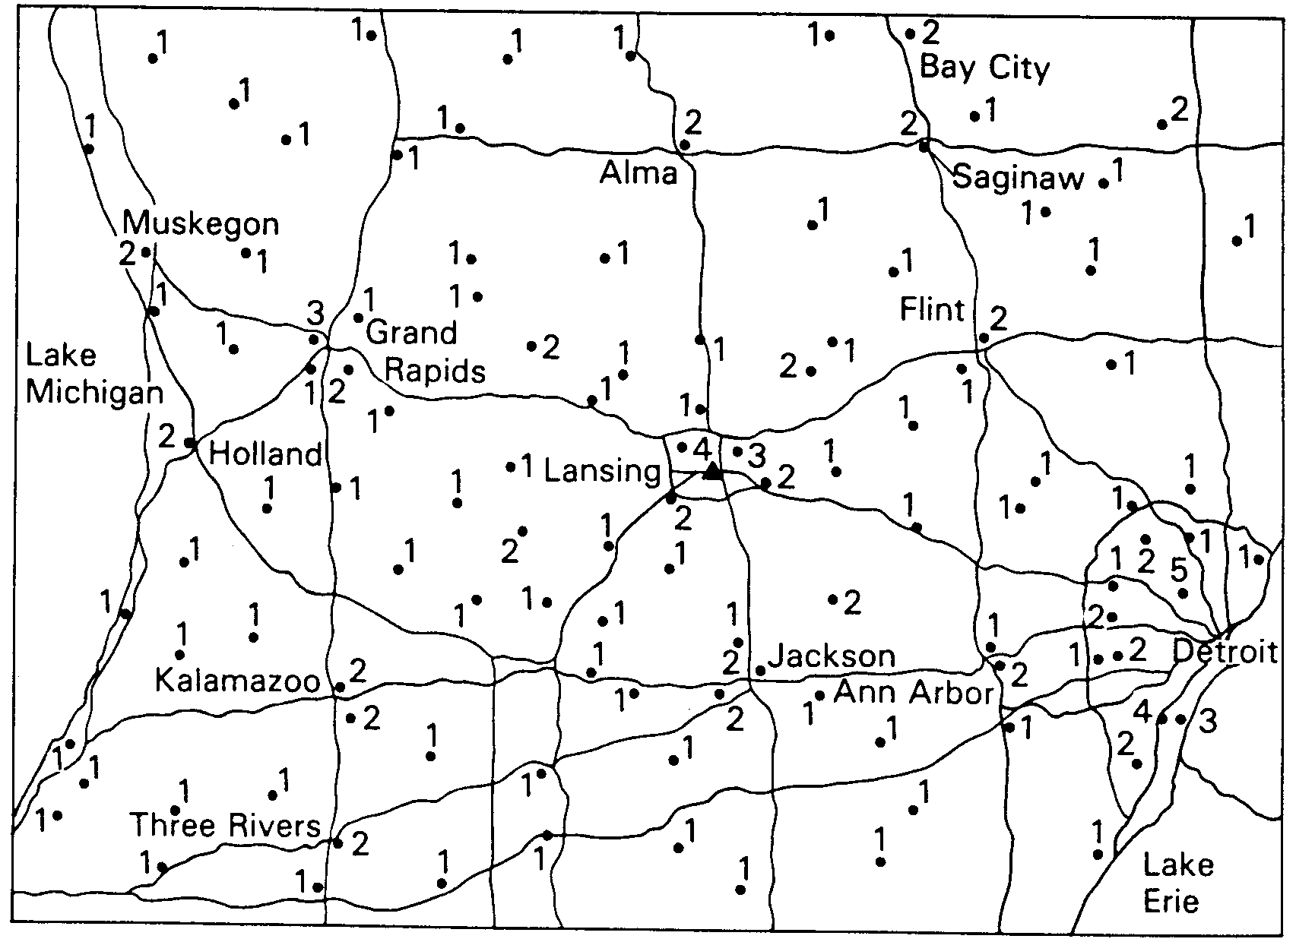
“Tear Drops”: Example
Warehouse
Funeral Homes & weekly demands

Slide 66
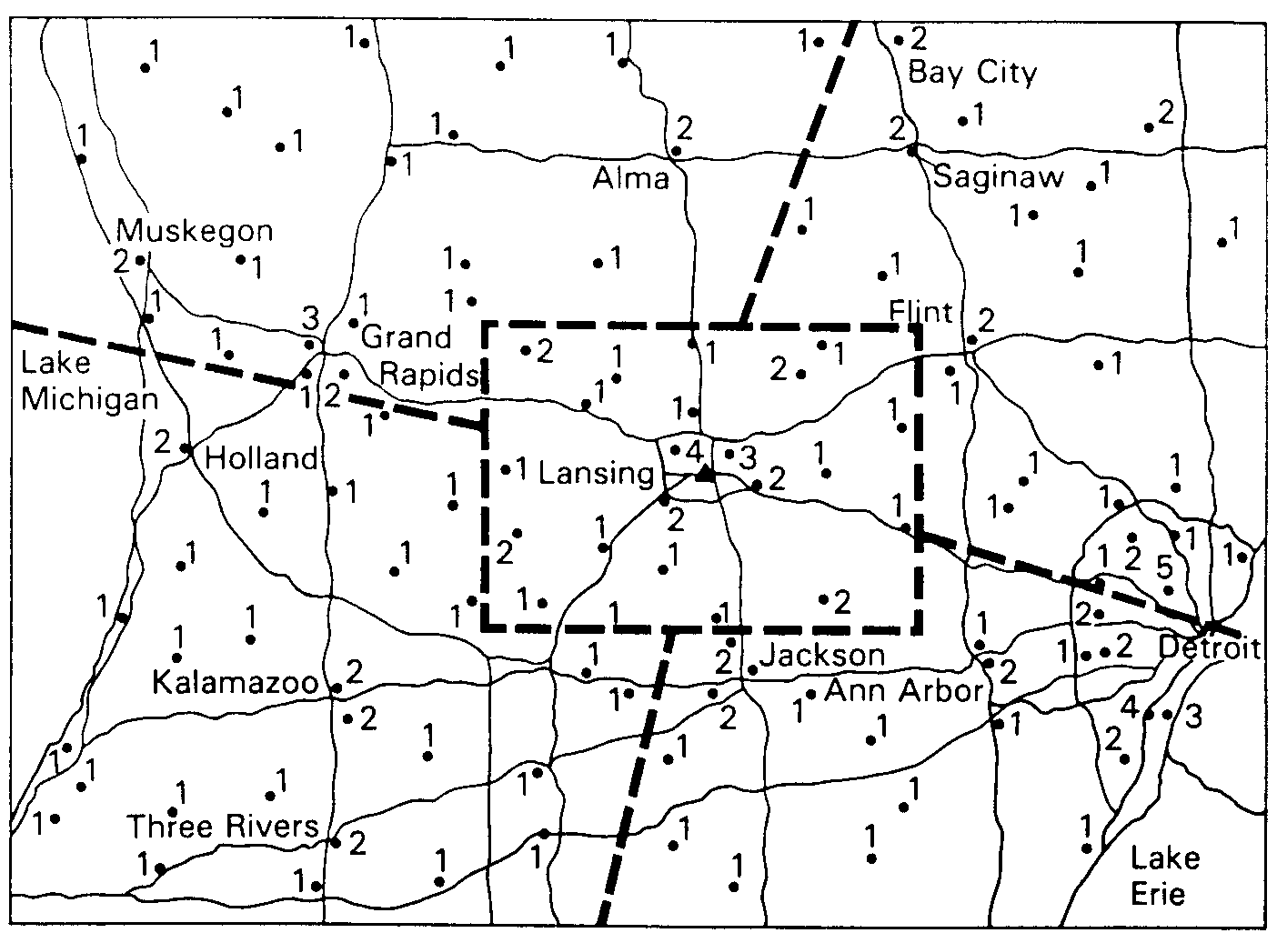
Example (cont.)
Territories of
equal size
to minimize
number of trucks
Begin with
farthest,
use largest
trucks first
Tear drop
pattern

Slide 67
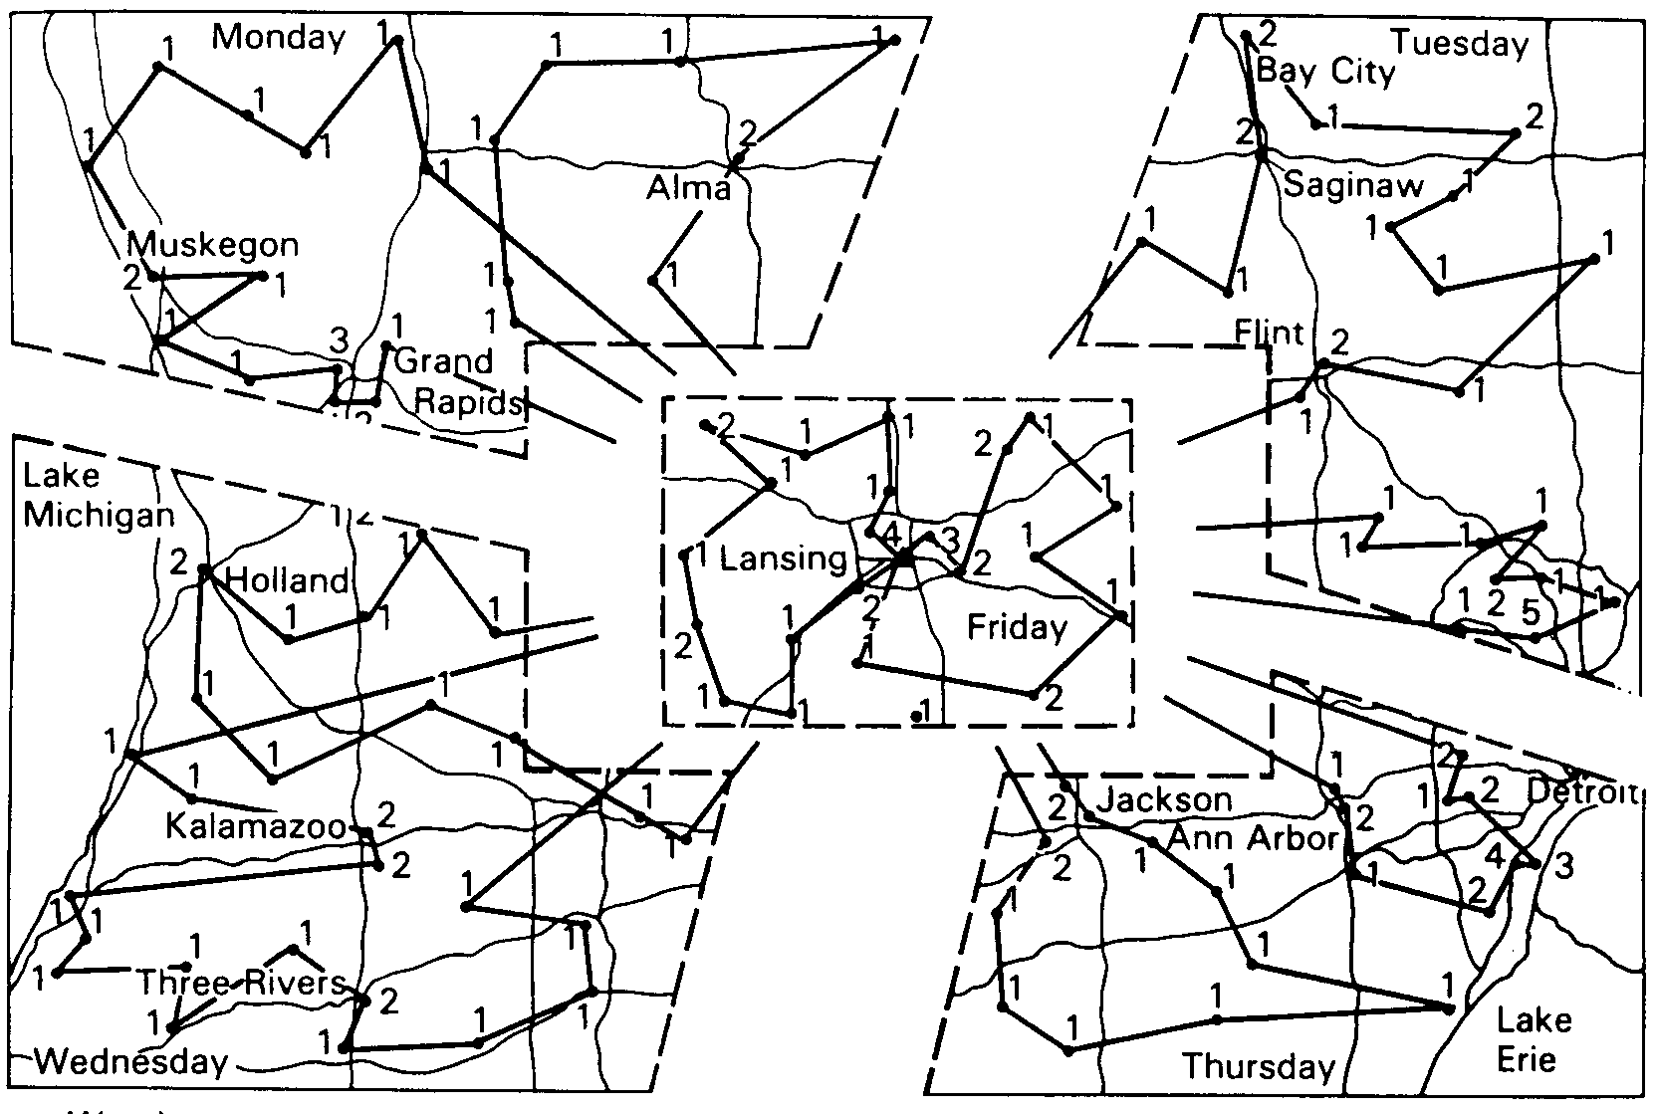
Example (cont.)

Slide 68
Guidelines (Cont’d)
3. Build routes beginning with the farthest stop from the depot
4. The stop sequence on a route should form a teardrop pattern
5. The most efficient routes are built using the largest vehicles available first
6. Pickups should be mixed into delivery routes rather than assigned to the end of the routes
7. A stop that is greatly removed from a route cluster is a good candidate for an alternate means of delivery
8. Narrow stop time window restrictions should be avoided (relaxed)

Slide 69
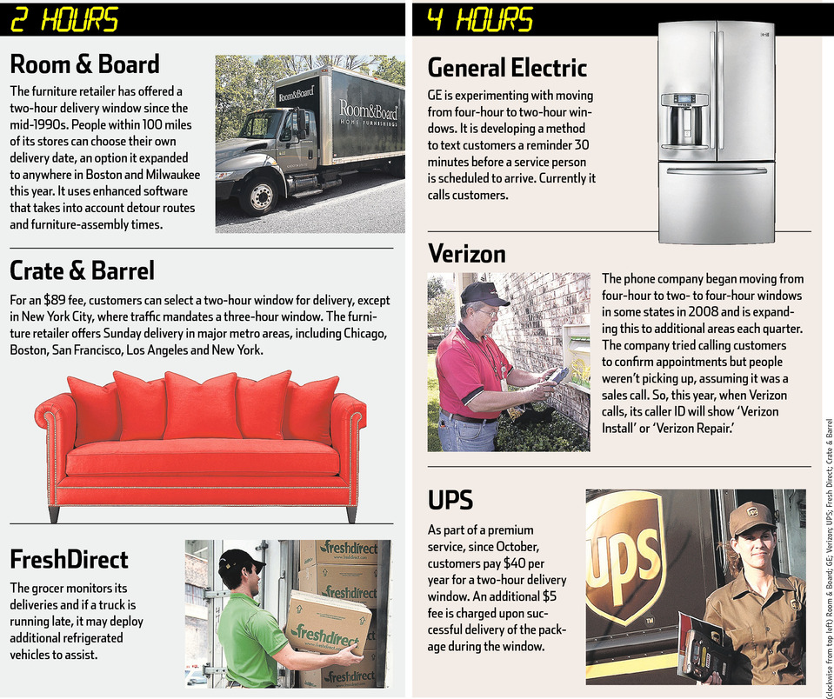
Routing Examples
Source: The Wall Street Journal, March 1, 2012, p. D1

Slide 70
Outline: Transportation Models
Mode/Service selection
Private fleet planning
  Routing from multiple points
  Vehicle routing and scheduling
Freight consolidation

Slide 71
Freight Consolidation
Combine small shipments into larger ones
Balance cost savings against customer service
An important area for cost reduction
Use rate-shipment size relationship of carriers
4 ways of shipment consolidation:
inventory consolidation
vehicle consolidation
warehouse consolidation
temporal consolidation

Slide 72
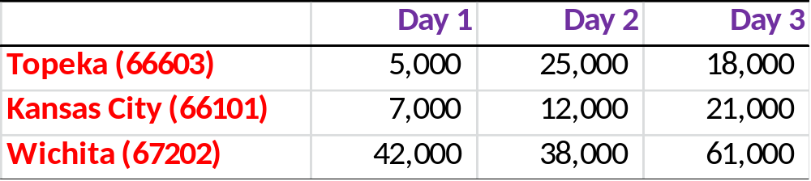
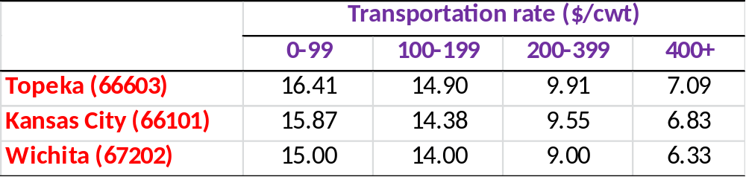
Example: Consolidation
Demand at three markets (in lbs)
Transportation Costs from DFW (76102)
What’s the impact of consolidation?

Slide 73
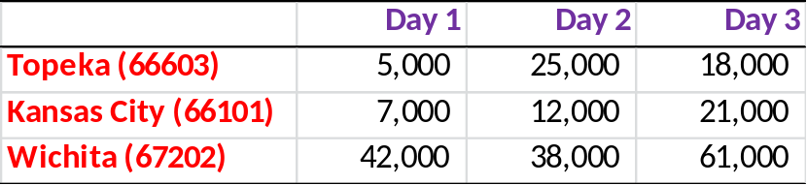
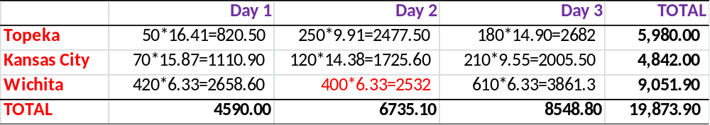
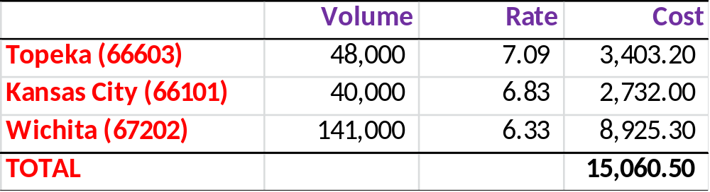
Example: Consolidation
Rate
CURRENT COST
COST UNDER FREIGHT CONSOLIDATION
$4,813.60
savings
Balance this against service requirements

Slide 74
Outline: Transportation Models
Mode/Service selection
Private fleet planning
  Routing from multiple points
  Vehicle routing and scheduling
Freight consolidation

Slide 75
Lecture Outline
Case: HP DeskJet
Intro to Transportation Planning
Transportation Modeling
Summary

Slide 76
Summary & Key Takeaways
Transport decision models
  Mode selection
  Demand allocation (vast application)
  Routing rules
  Freight consolidation
  Using Excel
Delayed differentiation/postponement

Slide 77
Next Class:
Facility Planning
Read
  Applichem Case (available in the eBook)
  eBook, p. 77-80, 83-84
Homework 4 (Applichem case, team) due
We will use Solver again!

